Slide 1
Price Prediction of US Airbnb Data
Using Multiple Linear Regression
6001CEM INDIVIDUAL PROJECT

Slide 2

Hello!
I am MUHAMMAD AFIF
Study in Bachelor of Computer Science
Supervisor: Dr. Trang Doan

Slide 3
Background and Motivation

Slide 4
Area of study
To illustrate the impact of appropriate price listings to Airbnb.
Recent research indicates that Airbnb hosts forfeit up to 46% of additional revenues because their listing is poorly priced (Gibbs et al., 2018).
This project may benefit to all companies that serve in real estate and tourism field.

Slide 5
Introduction

Slide 6
There are many factors that can affect the price of an Airbnb property.
In this project, those factors will be separated in two distinct group;
- Host-controlled variables :
Factors that can be handled or managed by hosts
- Out of host-controlled variables :
Factors that can’t be handled or managed by hosts
This results of this project also will be compared with a recent research conducted by McNeil & Paul (2020) who had used a limited number of variables to find out which group has more significance in price listing.

Slide 7
Recent Project Variables
Host-controlled Variables | Out of host-controlled variables
Bedrooms | Number of review
Bathrooms | City
Room type | Neighbourhood
Accommodates
Host is superhost

Slide 8
Current Project Variables
Host-controlled Variables | Out of host-controlled variables
Bedrooms | Number of review
Bathrooms | City
Room type | Neighbourhood
Accommodates | Rating review score
Host is superhost | Accuracy review score
Host has profile picture | Cleanliness review score
Year of experience | Check-in review score
Host identity is verified | Communication review score
 | Location review score

Slide 9
Project Objectives
Main objective:
To figure out the accuracy difference between 4 models and which model gives the most significance to price listings.

Slide 10
Hypothesis
Do additional trustworthiness attributes affect the significance of host-controlled features to the price listings?
Does enlarging the number of cities that comes with varieties of neighbourhood increase the impact to the out of host-controlled variables have on listing price?
Do out of host-controlled variables have more of a significance on listing price depending on the reputation attributes?

Slide 11
Methodology

Slide 12
Use AirBnb datasets from
5 different cities in US
(insideairbnb.com)
Chicago,
New Orleans,
Austin, New York,
Ashville

Slide 13
To determine the significance of host and out of host-controlled variables, two separate multiple linear regression models were created.
To provide more accuracy, a subset of listing price was created with prices < $1000 a night
Log transforming the listing price to fit a more normal distribution

Slide 14
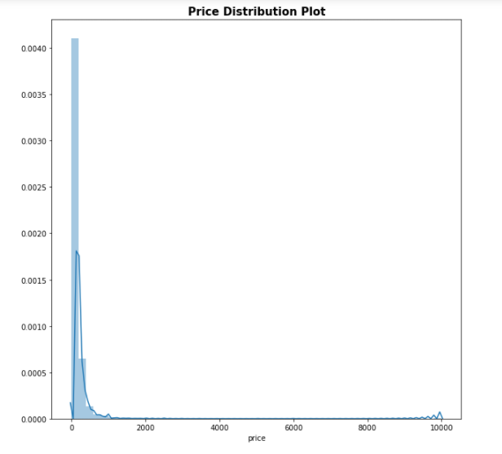
Initial price distribution

Slide 15
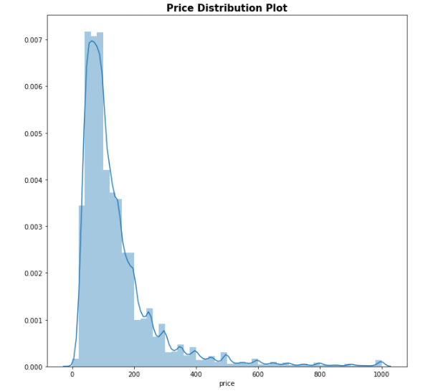
Price distribution with a subset of <$1000 per night

Slide 16
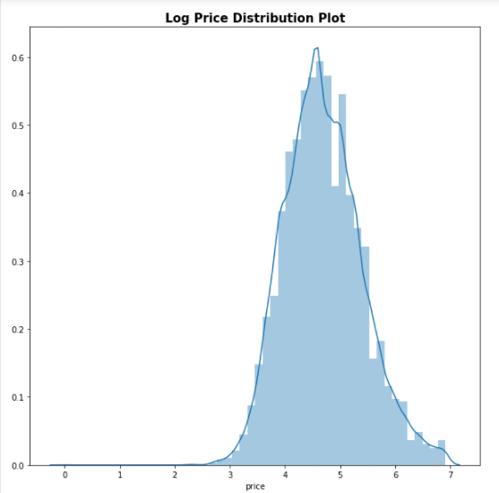
Price distribution with after log transforming

Slide 17
Recent Project Model
Host Variables Model | Mixed Variables model
Bedrooms | Bedrooms
Bathrooms | Bathrooms
Room_type (Hotel room) | Room_type (Hotel room)
Room_type (Private room) | Room_type (Private room)
Room_type (Shared room) | Room_type (Shared room)
Accommodates | Accommodates
Host_is_superhost_t | Host_is_superhost_t
 | Number of review
 | City [seatle]
 | Neighbourhood
 | +++

Slide 18
Current Project Model
Host Variables Model | Mixed Variables model
Bedrooms | Bedrooms
Bathrooms | Bathrooms
Room_type (Hotel room) | Room_type (Hotel room)
Room_type (Private room) | Room_type (Private room)
Room_type (Shared room) | Room_type (Shared room)
Accommodates | Accommodates
Host_is_superhost_t | Host_is_superhost_t
Host_has_profile_picture_t | Number of review
Host_identity_verified_t | City [Chicago]
Year_of_experience | Neighbourhood
 | Review_score +++

Slide 19
Implementation

Slide 20
Result Comparison
 | Compared HV Model | Compared MV Model | Current HV Model | Current MV Model
Training Set
Accuracy | 0.4845 | 0.4878 | 0.6140 | 0.6200
MSE | 0.2563 | 0.2547 | 0.1918 | 0.1890
RMSE | 0.5063 | 0.5047 | 0.4379 | 0.4346
R2 | 0.4845 | 0.4878 | 0.6142 | 0.6200
Adjusted R2 | 0.4845 | 0.4878 | 0.6143 | 0.6160
Testing Set
Accuracy | 0.4898 | 0.4930 | -1157721++ | -2197442++
MSE | 0.2519 | 0.2504 | 571752++ | 108523++
RMSE | 0.5019 | 0.5003 | 756143.42 | 1041743.76
R2 | 0.4898 | 0.4930 | -115772++ | -219744++
Adjusted R2 | 0.4898 | 0.4930

Slide 21
Analysis
The results shows that multiple linear regression shows a very bad result in testing set.
After some consultation with other supervisor, he suggested me to use a new train and test sample.
With my own analysis, I found out that the bad accuracy comes from neighbourhood variables. That is because some of the neighbourhood variables produce a very high p-value which is greater that 0.05. Thus, they are not significant in predicting price.

Slide 22
New Result
 | Mixed Variables Model
Training Set
Accuracy | 0.519
MSE | 0.238
RMSE | 0.489
R2 | 0.520
Adjusted R2 | 0.520
Testing Set
Accuracy | 0.518
MSE | 0.238
RMSE | 0.489
R2 | 0.520
Adjusted R2 | 0.520

Slide 23
Hypothesis result
Do additional trustworthiness attributes affect the significance of host-controlled features to the price listings?
It has small degree of significance
Does enlarging the number of cities that comes with varieties of neighbourhood increase the impact to the out of host-controlled variables have on listing price?
Enlarging number of cities does not have high correlation to out of host-controlled features
Do out of host-controlled variables have more of a significance on listing price depending on the reputation attributes?
It produces a slight significance to out of host-controlled variables

Slide 24
Conclusion

Slide 25
Conclusion
Host-controlled variables maintain gives higher significance to price listing compared to out of host-controlled variables
Regardless of the moderate accuracy result, adding other features and enlarge datasets do increase the model accuracy

Slide 26
Thanks!

